Slide 1

Chapter 22
Electric Fields
22-1 Charges and Forces 22-2 The Electric Field
22-3 The Electric Field Due to an Electric Dipole 22-4 The Electric Field Due to a Line of Charge 22-5 A Point Charge in an Electric Field
22-6 A Dipole in an Electric Field
Objective

Slide 2

22-1 Charges and Forces Field of charged particles
Charged particle q₁ sets up an electric field in all space.
→
F21
q₁
q₂
How does the point charge q₂ know about the presence of point charge q₁?

Slide 3


22-2 The Electric Field Definition
To feel the electric field of a charged particle q₁ at a point P, we bring a positive charged particle q₀ at point P and measure the force F₀₁ on q₀ from q₁.
→
F01
P
→
E
q₀
q₁
We will define the electric field of charged particle q₁ at point P as
→
→
E =
F01
.
q₀
We call q₀ a test charge.

Slide 4
22-2 The Electric Field
Electric field from more than one charged particle
The electric field from the charged particles q₁, q₂, q₃ at point P is
→
q₁
q₂
→
E =
F0,net
→
F0,net
.
q
→
E
q₃
0
P
q₀
At each point in space, you can find the electric field by the same method.
q₀ is a positive test charge

Slide 5
22-2 The Electric Field Lines Representing electric field direction
We use electric field lines to help us representing the electric field.
→
E
electric field lines
At any point, the tangent of the electric field lines gives the direction of the electric field.

Slide 6
22-2 The Electric Field Lines Representing electric field strength
We use electric field lines to help us representing the electric field.
Electric field lines
Imaginary unit area
Strong electric field
Weak electric field
Number of lines per unit area in a plane perpendicular to the electric field lines is proportional the magnitude of the electric field.

Slide 7
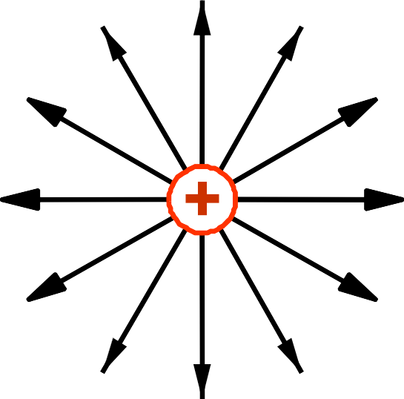
22-2 The Electric Field Lines
Electric field lines of a positive point charge
→
E
Strong electric field
q₀
Weak electric field
q₀ is a positive test charge

Slide 8
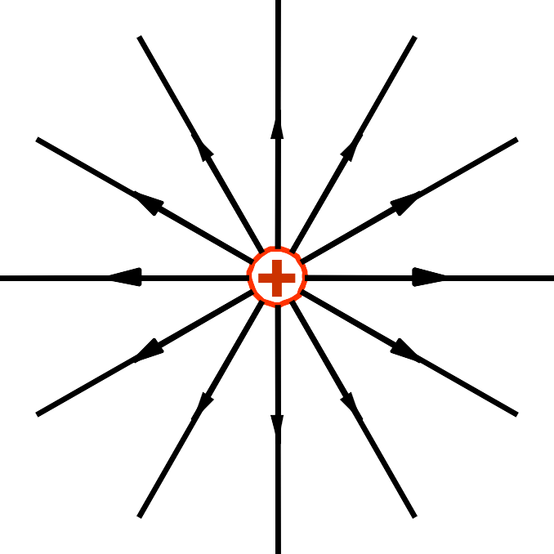
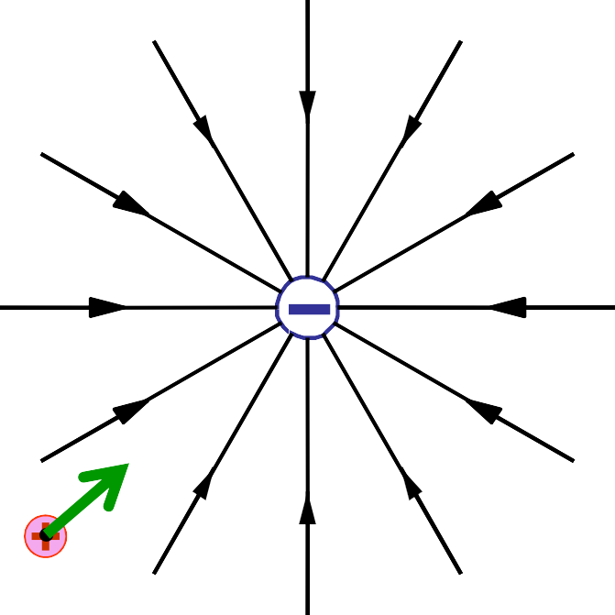
22-2 The Electric Field Lines Electric field lines direction
→
E
q₀
Electric field lines extend away from positive charge and toward negative charge.

Slide 9
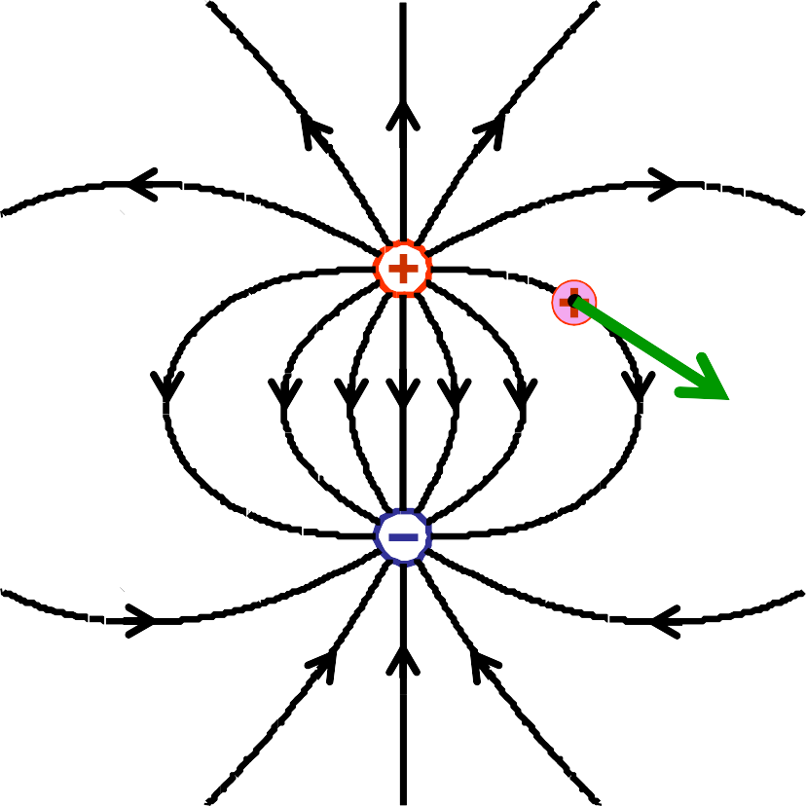
22-2 The Electric Field Lines
Electric field lines from a positive and a negative point charges
q₀
→
E
Electric field lines extend away from positive charge and toward negative charge.

Slide 10
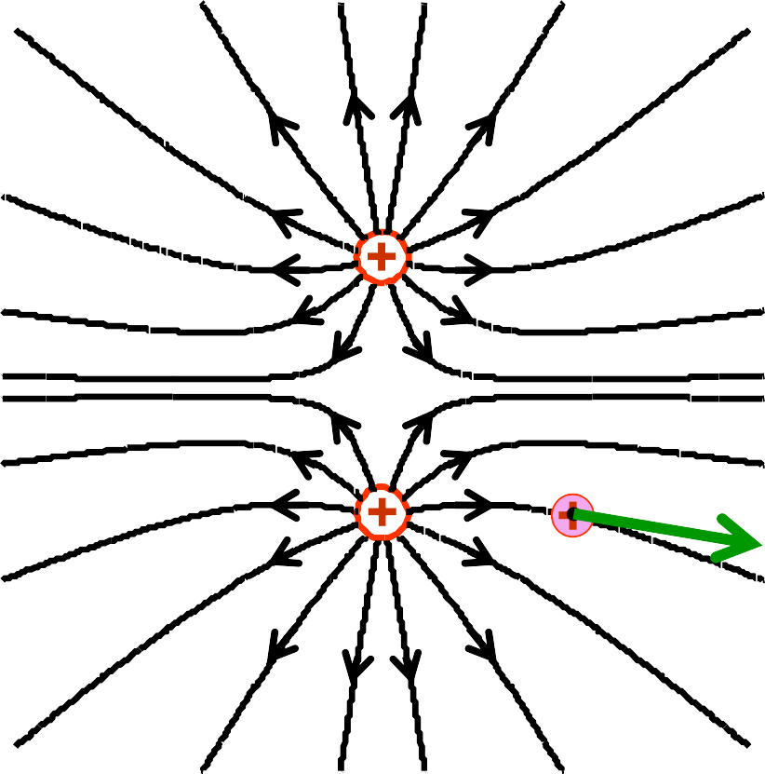
22-2 The Electric Field Lines
Electric field lines from two equal and opposite point charges
→
E
q₀
Electric field lines extend away from positive charge and toward negative charge.

Slide 11
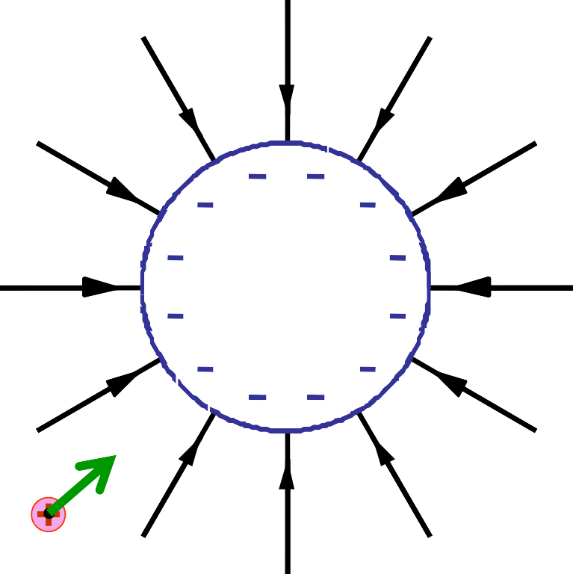
22-2 The Electric Field Lines
Electric field lines from a sphere of uniform negative charge
a sphere of uniform negative charge
→
E
q₀

Slide 12


22-2 The Electric Field Lines
Electric field lines from a very large nonconducting sheet
→
E
→
E
a very large nonconducting sheet
Side view

Slide 13
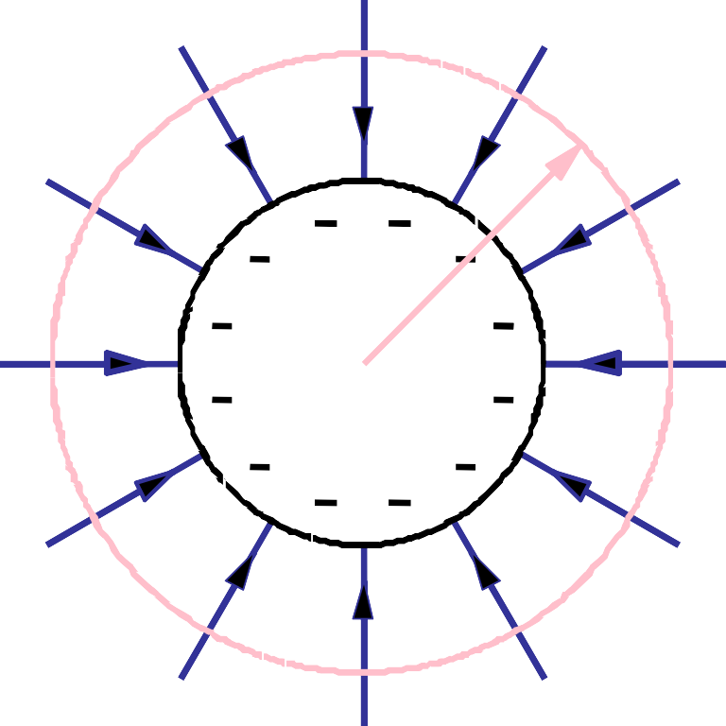
22-2 The Electric Field Lines Example 1
Use an argument based on electric field lines to describe how the electric field varies with the distance from the center of a uniformly charged sphere.
Solution
The magnitude of the electric field is proportional to the number of lines per unit area in a plane perpendicular to the lines.
r
Suppose we have a number of N lines extend toward the sphere.
For any imaginary sphere with radius r and concentric with the charged sphere,
the number of lines per unit perpendicular to
the imaginary sphere is
The magnitude of the electric field varies
N
as the inverse square of the distance form the center of the sphere.
∝ E
4π r²

Slide 14

22-2 The Electric Field Due to a Point Charge Formula
→
F0
P
→
E
q₀
q
_{k} |q₀ ||q|
_{r}2
_{= k} |q|
E = ^{F0}
=
_{r}2
q
q
0
0
_{E = k} |q|
_{r}2
For a point charge

Slide 15
22-2 The Electric Field Due to a Point Charge Superposition principle
q₂
q₃
q
1
P
→
E
→ → → →
E = E₁ + E₂ + E₃
Superposition principle

Slide 16
22-2 The Electric Field Due to a Point Charge Checkpoint 1
What is the direction of the electric field due to the electron at
point S
point R
What is the direction of the net electric field at
point S
(d) point R
p
-e
S R
Solution
-e
p
S
R

Slide 17
22-2 The Electric Field Due to a Point Charge Example 2
What net electric field is produced at
y
the origin?
Solution
y
q₁ = +2Q
q = - 4Q
d
d
3
30⁰
30⁰
x
→
E3
30⁰
d
q₂ = - 2Q
30⁰
30⁰
x
E₁ = k
2Q
→
d
2
→
E2
E1
E₂ = k
2Q
d
2
y
4Q
E₃ = k
Same magnitude
_{d}2
E₁ + E₂ = k
→
E3
4Q
d
2
→
E
The electric field produced at the origin has a magnitude of
30⁰
30⁰
x
E = 2( k
4Q
)cos(30⁰ )
→ →
E1 + E2
_{d}2
It points along the positive x-axis.

Slide 18
22-2 The Electric Field Due to a Point Charge Checkpoint 2
Rank the magnitude of the net electric field at the origin, greatest first.
y
y
-5q
-5q
x
x
2q
-3q
-3q
2q
y
y
-q
x
x
4q
-q
q
-4q
Solution
All tie.
5q
4q

